Slide 1
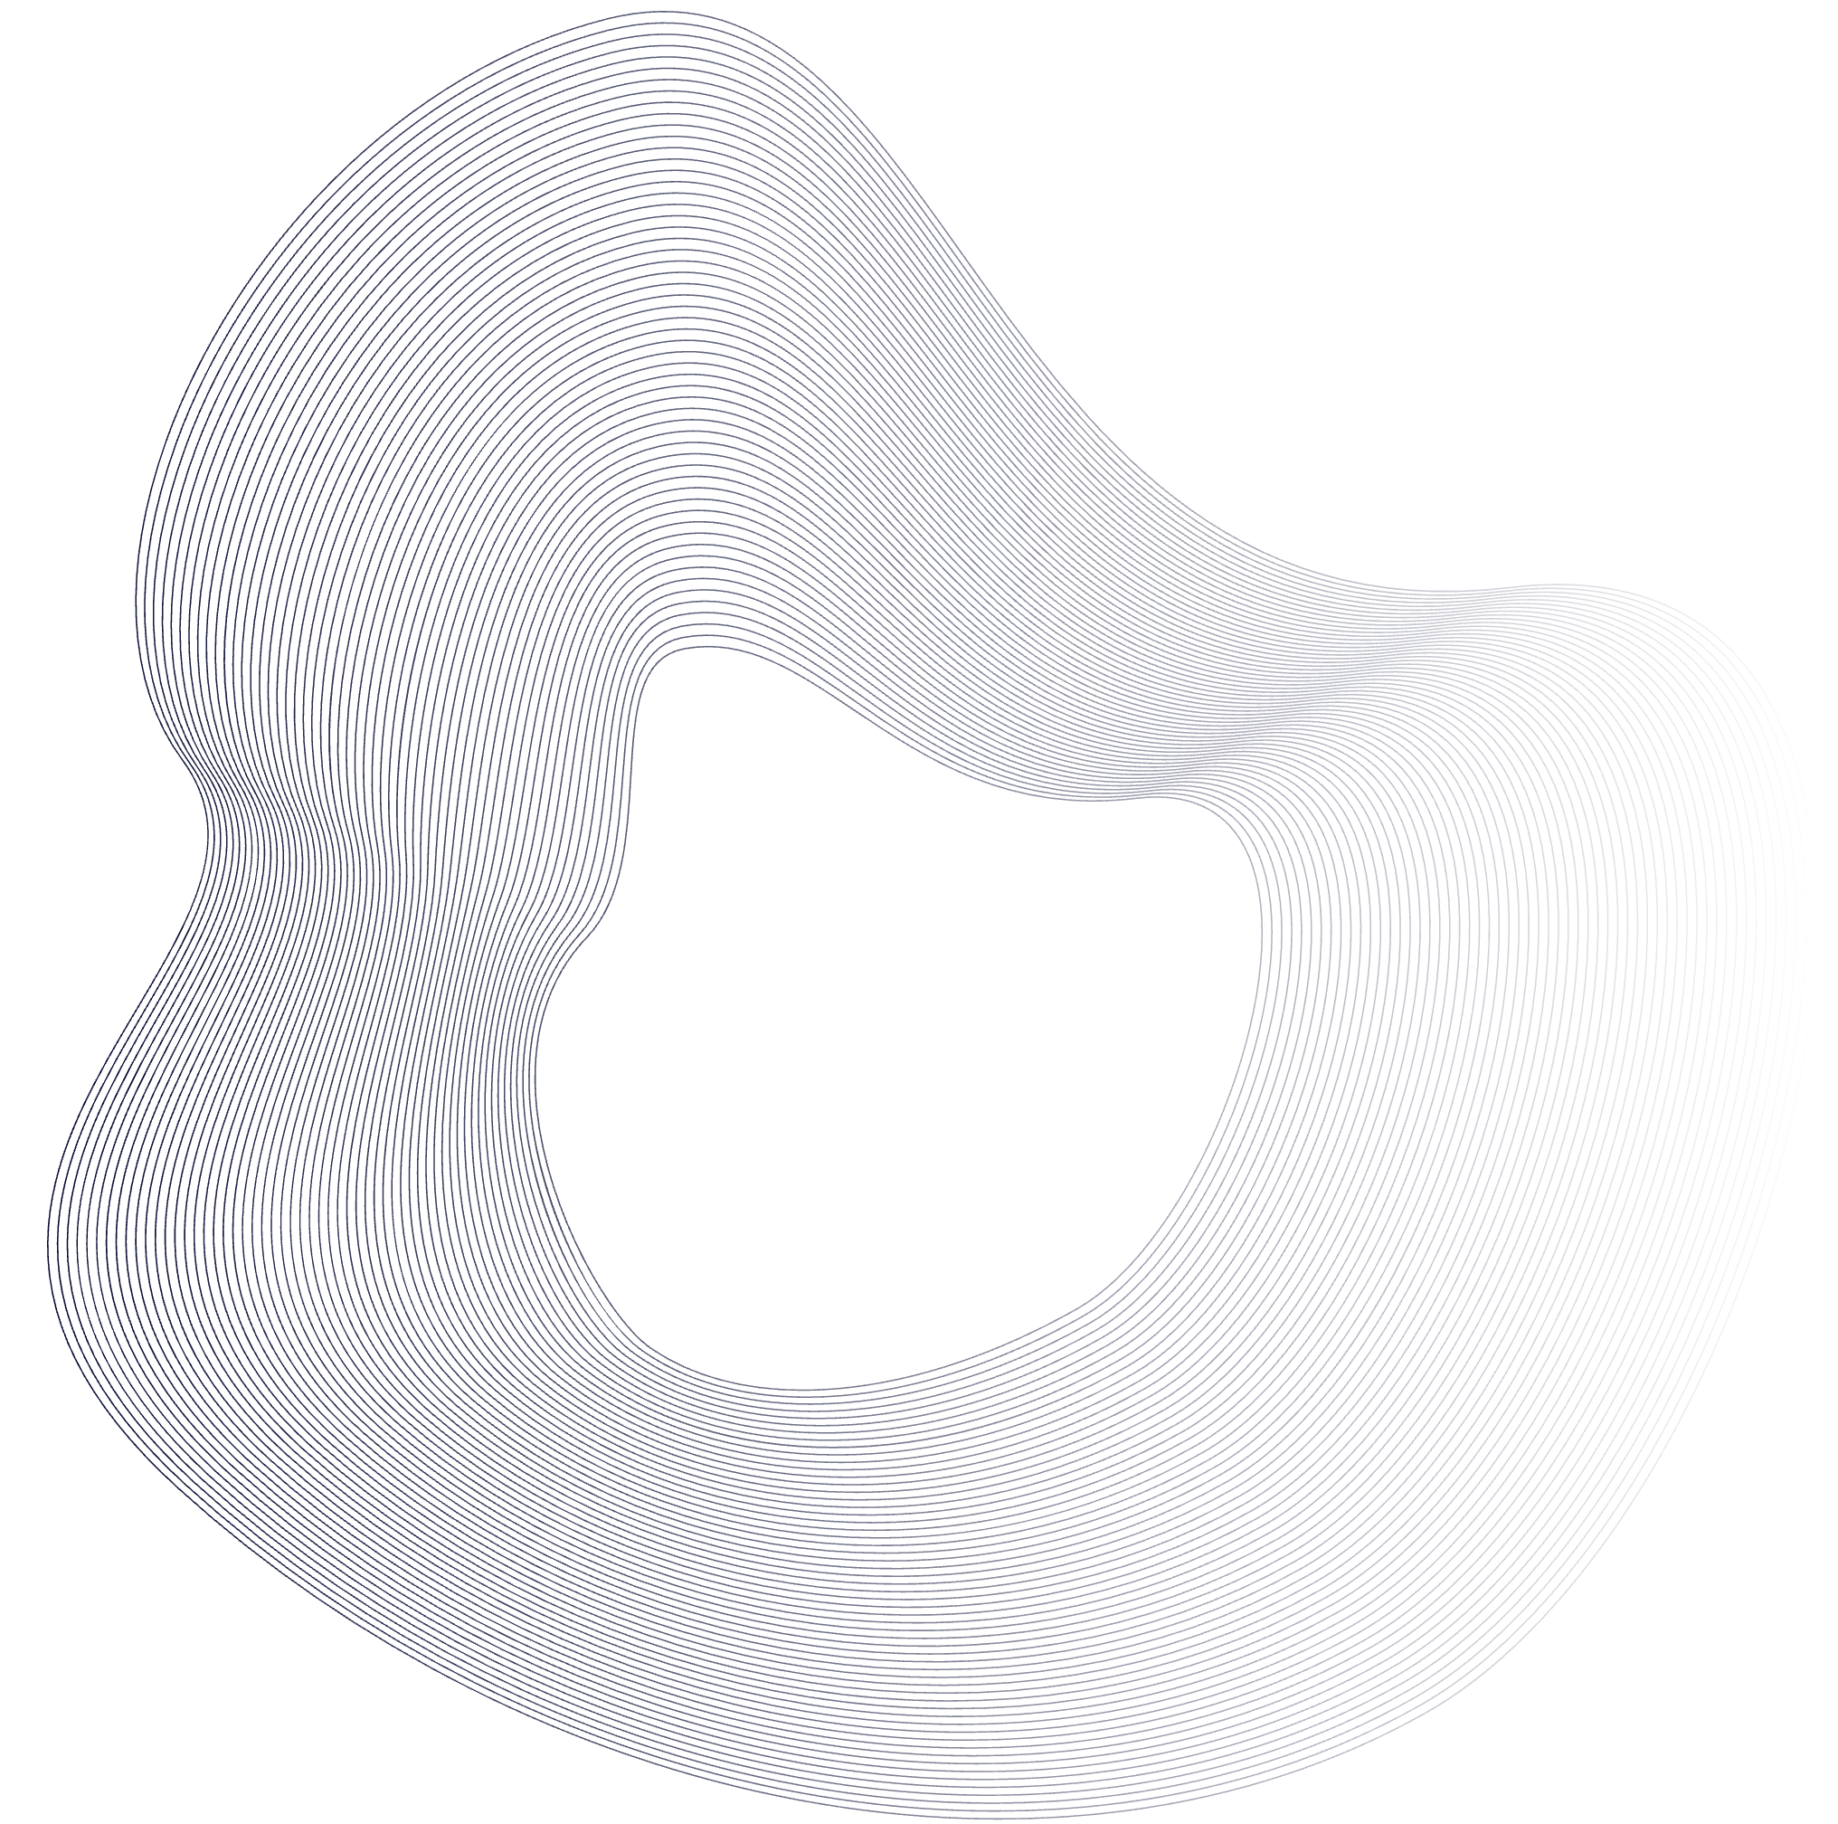
TASK MANAGEMENT AND INSIGHTFUL PRODUCTIVITY TRACKING
PLANORAMA
Team 22: Sruthi Bhamidipati, Yana Sheoran, Vihaan Khajanchi, Jack Kenny

Slide 2

PROBLEM MOTIVATION
Many productivity tools focus narrowly on individual tasks, scheduling, or collaboration, forcing users to rely on multiple apps to manage their work. This often creates fragmented workflows and makes it harder to stay organized. Planorama combines task management, team coordination, and productivity tracking into a single, intuitive platform that helps users keep everything in one place and work more efficiently.

Slide 3

PROJECT GOALS
CENTRALIZE TASK MANAGEMENT
Allow users to easily create, view, and organize tasks in one place to streamline daily planning and avoid scattered workflows
SUPPORT TEAM COORDINATION
Support collaboration through shared tasks, assignments, comments, and team structures to help groups manage work together efficiently
TRACK PROGRESS AND PRODUCTIVITY
Provide visibility into task completion, time spent, and weekly activity to help users monitor their work
ENABLE FLEXIBLE WORKFLOWS
Support subtasks, dependencies, scheduling, rollovers, and filtering to help users manage complex tasks and adapt structures to fit their workflow

Slide 4
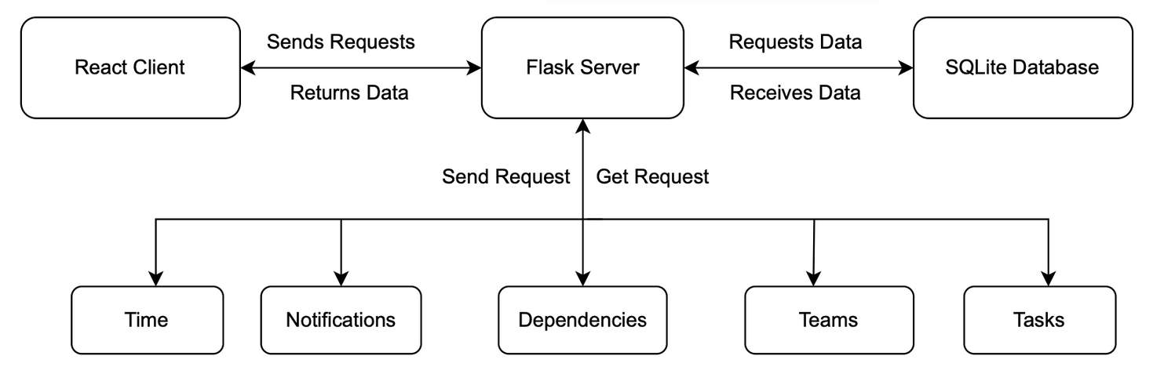
DESIGN OUTLINE
Planorama uses a client-server architecture to manage user interactions and store data efficiently. The web client provides an interactive interface, while the server handles requests and communicates with an SQLite database for persistent storage.
This structure separates concerns between the interface, application logic, and storage, making the system easier to maintain and expand.
Backend components process user actions and manage data flow to support smooth task management, organization, and collaboration

